Slide 1

Deploying ML models
Facilitated by:
Vrushali Sarwan
Senior Facilitator
Email: vrushalis@regenesys.net

Slide 2
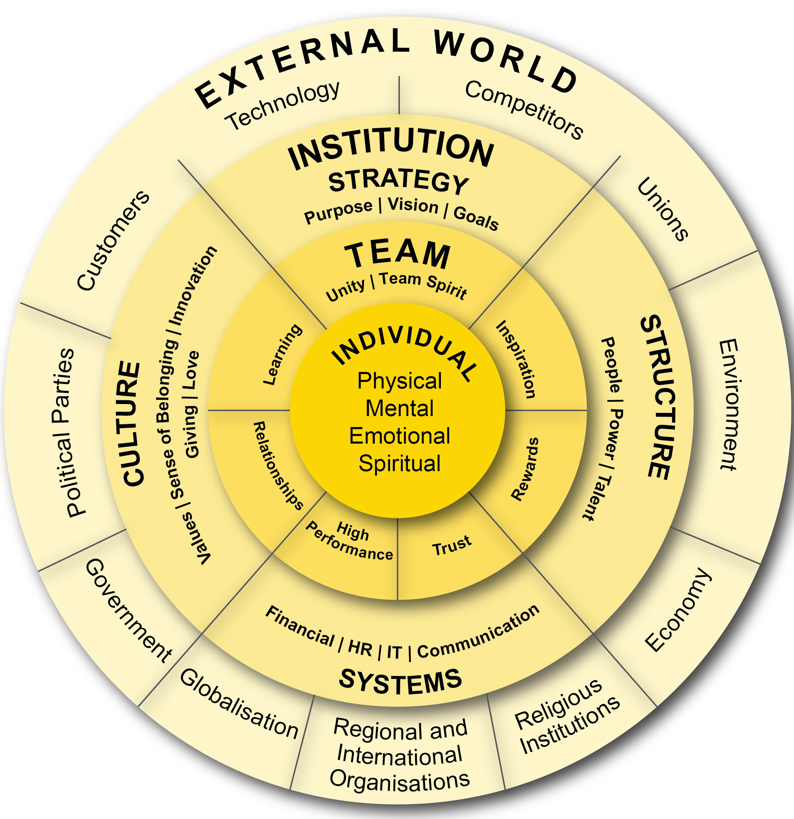





REGENESYS’ Integrated Leadership and Management model
Holistic focus on the individual (SQ, EQ, IQ, and PQ)
Interrelationships are dynamic between individual, team, institution and the external environment (systemic)
Strategy affects individual, team, organisational, and environmental performance
Delivery requires alignment of strategy, structure, systems and culture

Slide 3
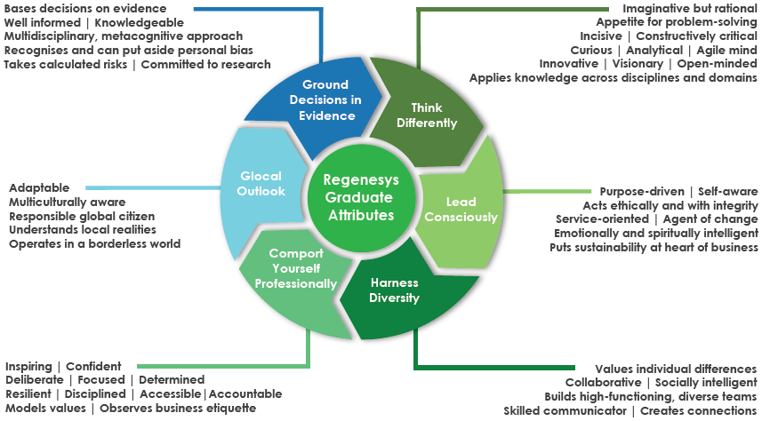
REGENESYS’ Graduate Attribute

Slide 4
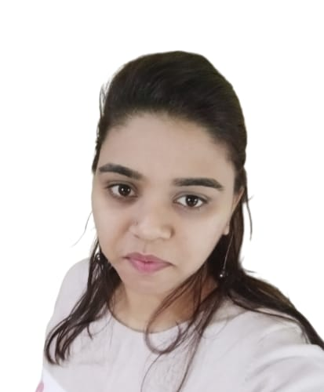
Vrushali Sarwan
With 8 years of expertise spanning Machine Learning, Artificial Intelligence, Data Analytics Tools, Natural Language Processing, Training & Facilitation, and Academia
Qualifications-
M.S.(Specialization- Data Science)
B.S.(Computer Science)
Well versed in programming languages - C, C++, Python, R. Concepts- Data Structures, HTML, CSS, Java Script, Object-oriented analysis. Tools – Excel, PowerBI.
Provided Expert Guidance on Projects
Bagged a few Research Publications
Vrushali Sarwan|vrushalis@regenesys.net

Slide 5
Ground Rules
Active Listening
Listen attentively, understand, and respond effectively
Respectful Communication
Communicate openly and respectfully with your peers and facilitators
Come Prepared
Arrive with the necessary information and materials for productive discussions
Be on Time
Respect others' time and be punctual for all engagements
Embrace Challenges
View challenges as opportunities for growth and learning
Follow Online Etiquettes
Adhere to respectful and professional behavior in virtual learning
Have fun and enjoy the learning!

Slide 6
Learning Objectives
Understand what Streamlit is and why it's useful
Build a interactive web app with frontend inputs and backend logic
Build a simple Car Price Prediction app using Streamlit

Slide 7
Streamlit
Streamlit is an open-source Python library for building interactive web apps for data science and ML with minimal effort.
Why use Streamlit?
No need to know HTML/CSS/JS
Great for prototyping and dashboards
Use cases:
Model demos, dashboards, internal tools

Slide 8
Input Widget
st.text_input()
st.number_input()
st.slider()
st.selectbox()
st.button()

Slide 9
Common Widgets
Widget | Function | Example Use Case
st.text_input() | Text entry from user | Name, username
st.number_input() | Numeric input | Age, weight, height
st.slider() | Select value using a slider | Ratings, range filters
st.selectbox() | Dropdown menu | Category selection
st.checkbox() | Toggle on/off (True/False) | Accept terms, enable options
st.radio() | Single choice from options | Gender, filters
st.button() | Click to trigger actions | Submit, calculate, refresh
st.date_input() | Pick a calendar date | Bookings, events
st.time_input() | Select a time | Alarms, scheduling

Slide 10
Output Widget
st.write()
st.text()
st.markdown()
st.success(), st.error(), st.warning

Slide 11
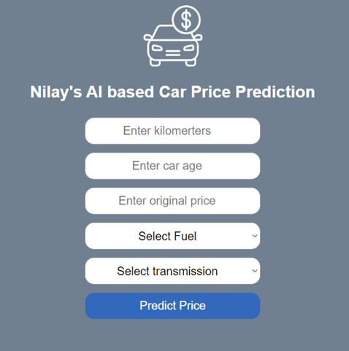
Project 3 : Used Car Price Prediction Model (using random forest regressor )

Slide 12
Summary
Streamlit is a python library to build web apps for data science & ML
Lightweight and fast
No front-end experience needed

